Slide 1
Boosting Algorithm

Slide 2
Boosting Algorithm – Regression
* Ada Boost
* Gradient Boost
* XG Boost

Slide 3
Ada Boost :
* Ada Boost is an group model that continuous builds new models based on the errors of the previous model to improve the predictions.
* And most of the case used in Decision Tree Models.
* Ada boost also can use in both Classification and Regression.
* One of the Decision Tree model we see in next.

Slide 4
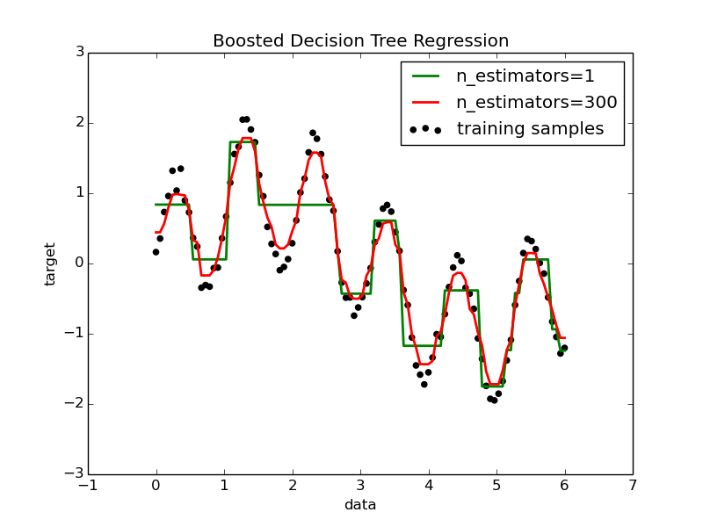
Decision Tree Regression with AdaBoost:
* A decision tree is boosted using the AdaBoost.
* Algorithm on a 1D dataset with a small amount of Gaussian noise. 299 boosts (300 decision trees) is compared with a single decision tree regressor.

Slide 5
Gradient Boosting :
* Gradient boosting it is also use for both Classification and Regression.
* A Gradient boosting start with an average prediction and improves it through multiple trees.
* Each one fixing the previous trees' mistakes in small steps, until reaching the final prediction.

Slide 6
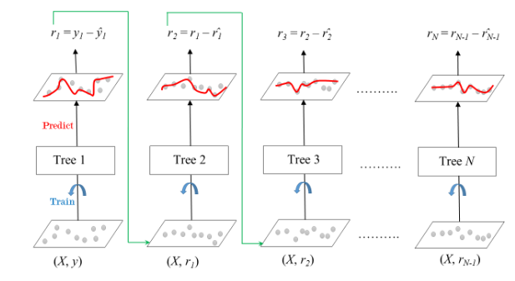
* The ensemble consists of M trees. Tree1 is trained using the feature matrix X and the labels y.
* The predictions labeled y1 are used to determine the training set residual errors r1
*Tree2 is then trained using the feature matrix X and the residual errors r1 of Tree1 as labels..

Slide 7
XG Boost :
* XGBoost regression is a machine learning technique for predicting continuous numerical values.
* It's a popular and effective tool for regression tasks.
* It's based on decision trees and improves on other methods like gradient boost and random forest.
* XGBoost expects to have the base learners which are uniformly bad at the remainder so that when all the predictions are combined, bad predictions cancels out and better one sums up to form final good predictions.

